Slide 1

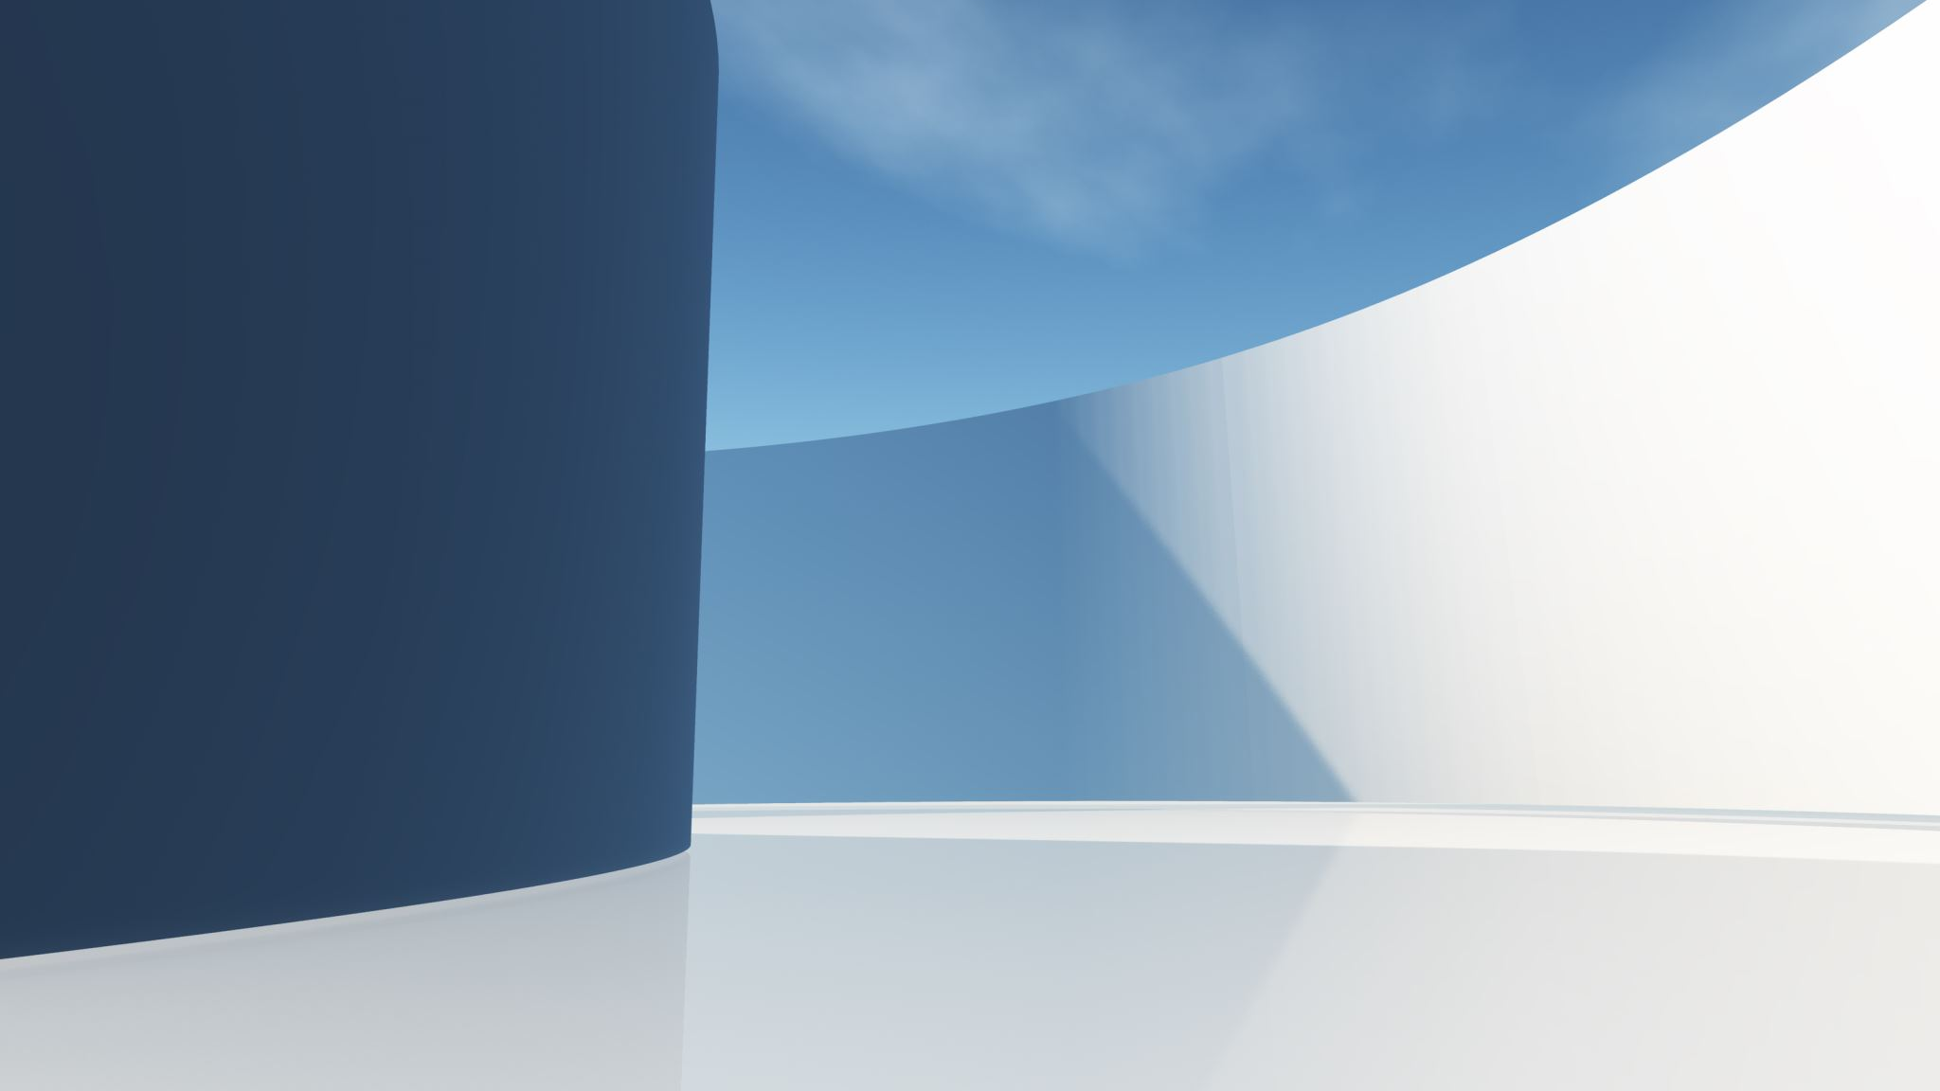

By Ryan Trader and Andrew Tucker

Slide 2

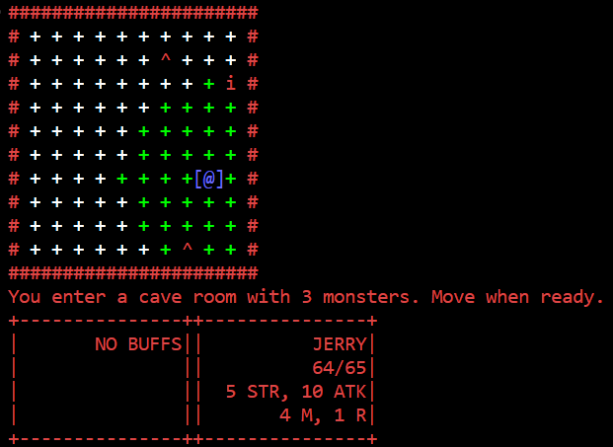
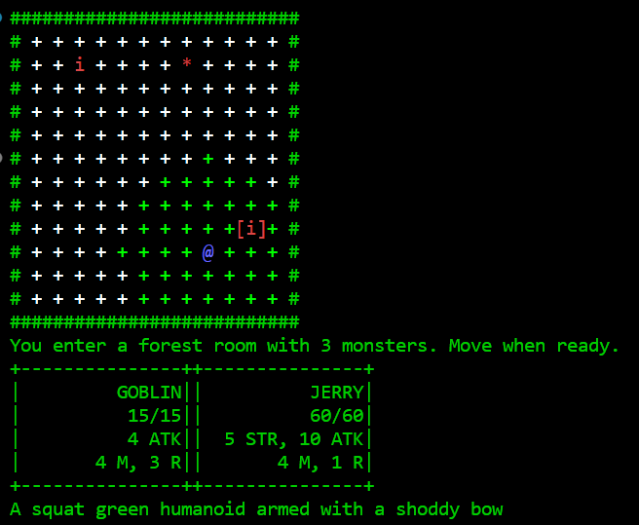
What is Jerry’s Quest?

Slide 3

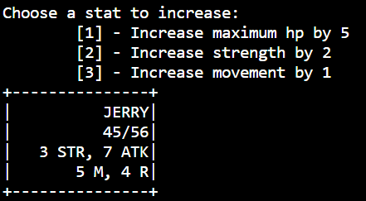
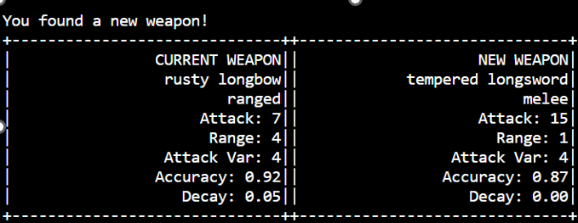
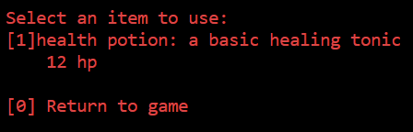
Features
5 Unlockable Characters (Classes)
37 Different Enemies
40+ Maps
3 Different Room Themes
281 Weapons
9 Save Slots
9 Inventory Slots Per Save
3 Different Consumables
Unique Enemy AI
Permanent Stat Buffs
Real-Time Input
Overwriting Prints

Slide 4


How it Works

Slide 5
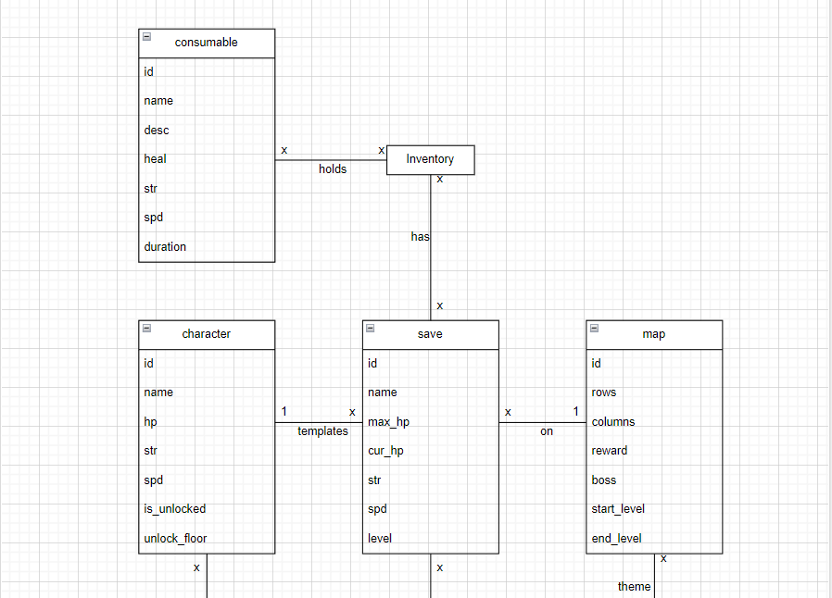
UML Diagram

Slide 6
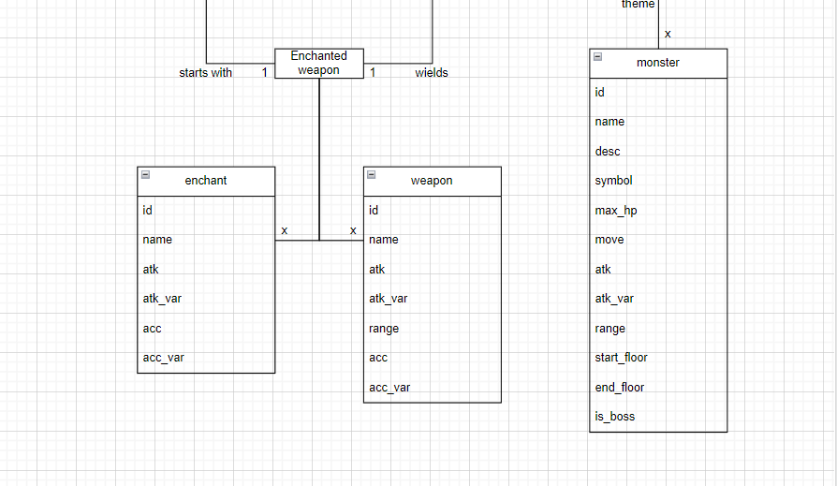
UML Diagram (Continued)

Slide 7
Thank You

